Slide 1
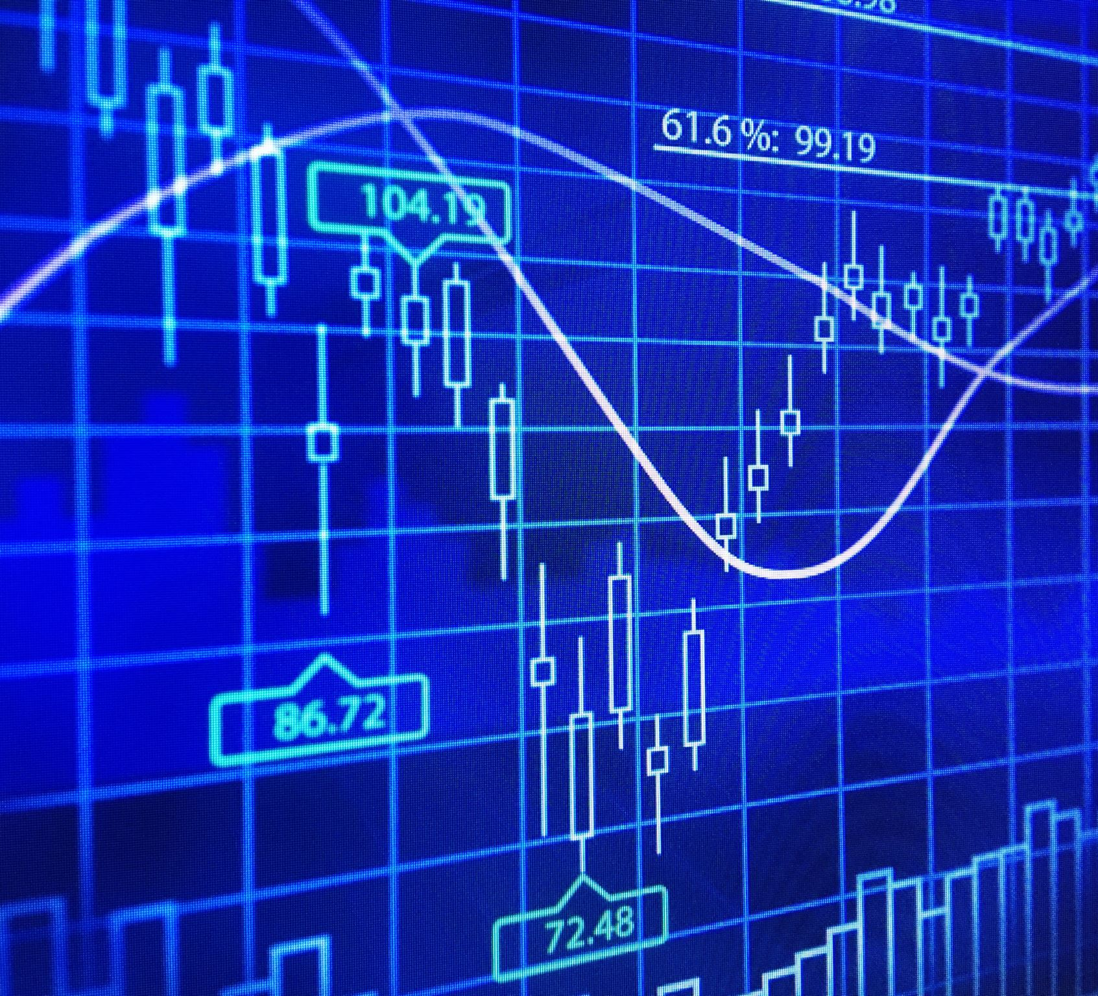
Analysis for Understanding
Session 2

Slide 2

Using OLS to Estimate Effects

Slide 3

New “Big Franchise” Game
Social media element, but players may not engage with it
Assumption: more you play, more you will engage

Slide 4
Example
Hours Played
Social Media Engagement
Goal: estimate effect of “hours played”

Slide 5
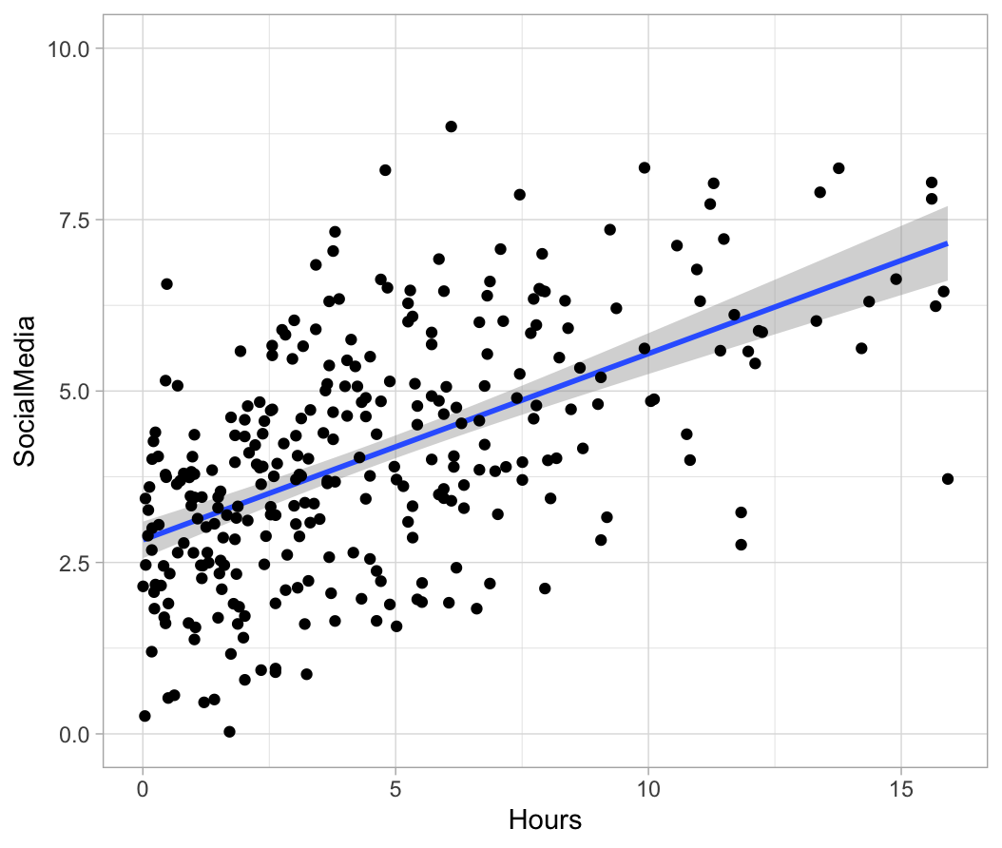
OLS Regression
Intercept:
Average “Y” when x = 0
2.87
Slope
Average 𝛥Y for 1-unit increase in X
0.26
Notes:
Social media engagement scored 0-10. Usage is respectable and increases with hours.

Slide 6
Effect Focus
Prediction is not the goal
Estimate of effect of hours
Slope of 0.26 = effect size

Slide 7
Caveat
Estimated
Real effect could be zero!
p-value: % of time this effect size (or larger) occurs when real effect is zero
Here, p < .001

Slide 8
Other Effect Sizes
R² = % variance in Social Media explained by hours
R² = 31%

Slide 9
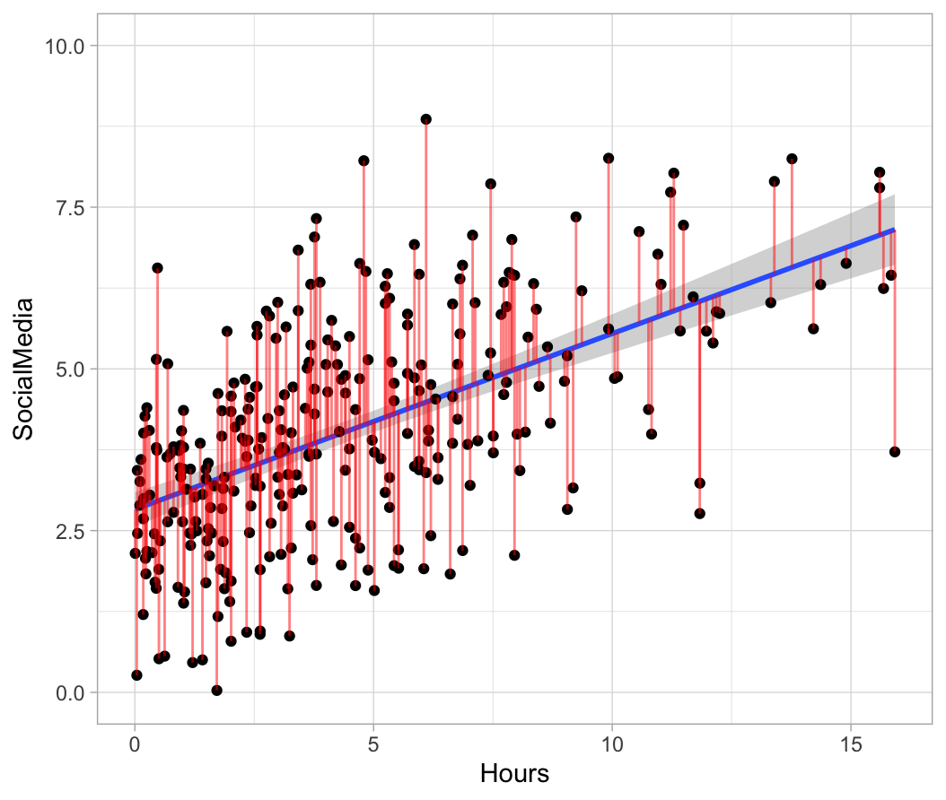
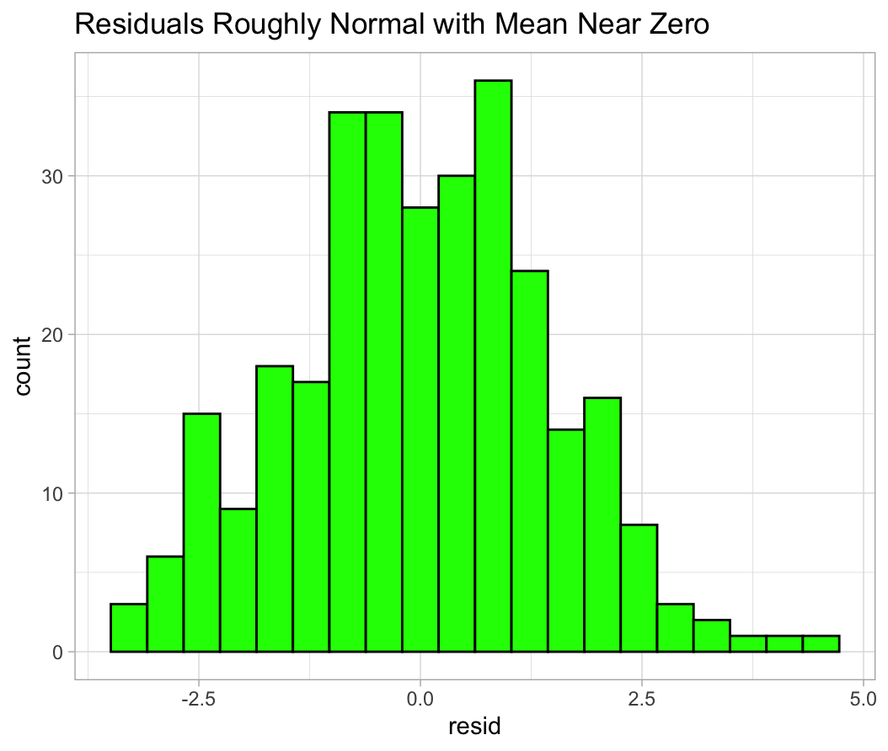
Residuals
Assumption: residuals do not vary as a function of X
Residuals are approx. normal, M = 0

Slide 10
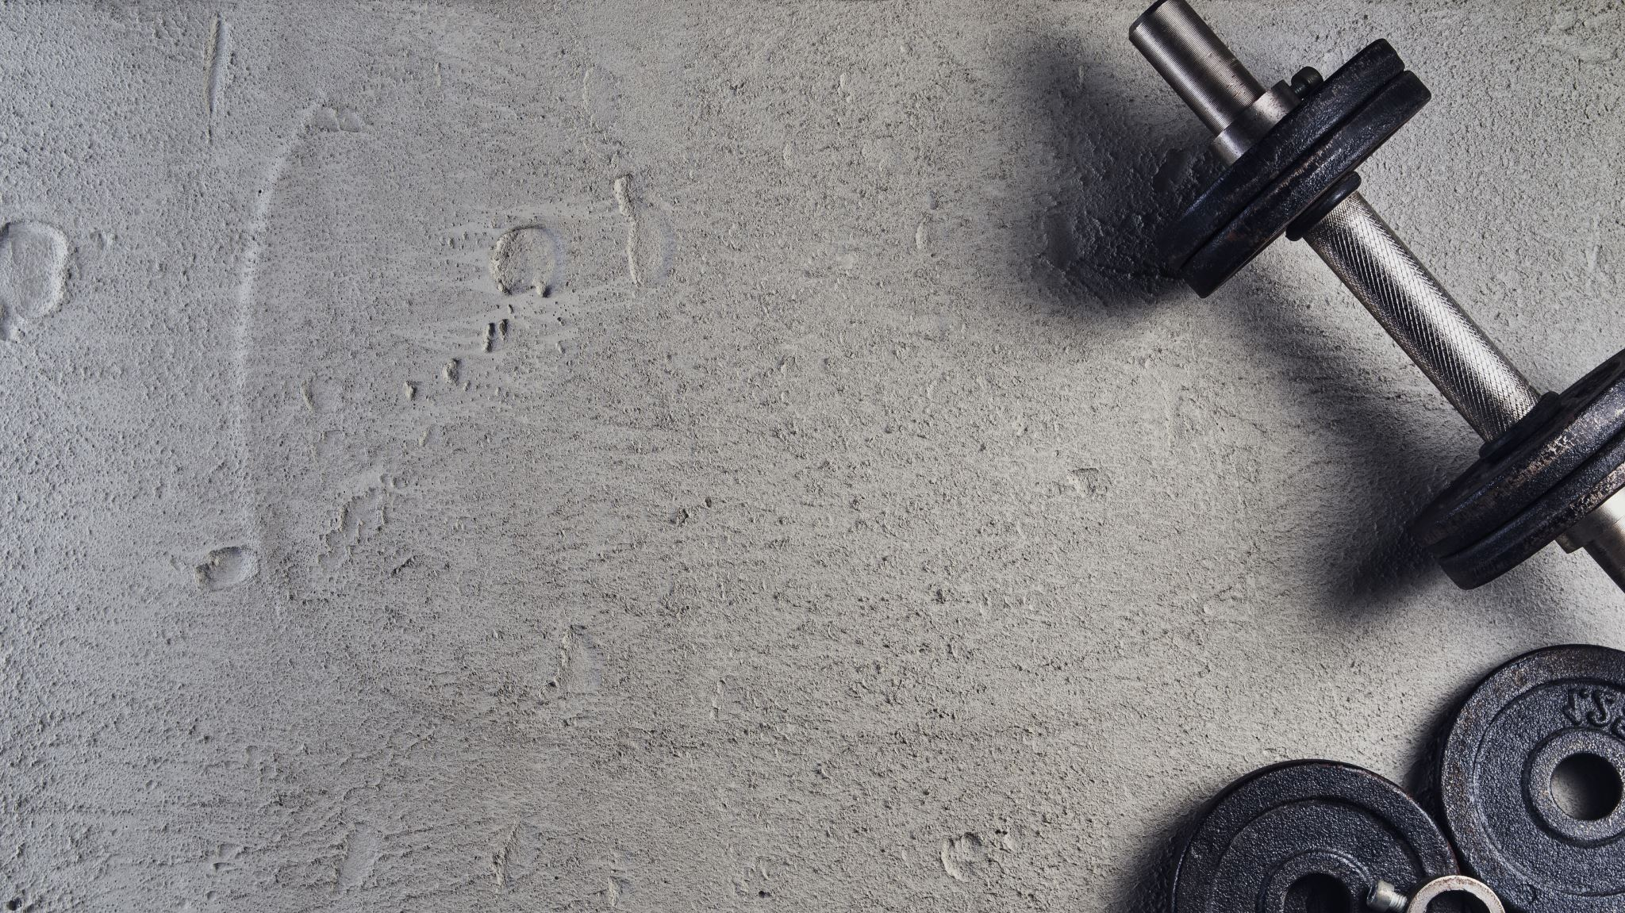
Python Exercise

Slide 11
Controlling Confounders

Slide 12
Warning
Effect sizes may be biased by confounders

Slide 13
Can We Use It?
Effect size is biased by confounders. Can we still use this data?
Yes*, with appropriate statistical controls

Slide 14
Example
Hours Played
Social Media Engagement
??
Fan
Problem: being a fan of the series will lead to both hours played and engagement. If we can measure this, we can control for it
Notes:
Both HOURS PLAYED and FAN go to SME. To estimate the effect of either, the other must be controlled.

Slide 15
Statistical Control
Hours
Soc. Media

Slide 16
Statistical Control
Hours
Soc. Media
Fan

Slide 17
Statistical Control
Hours
Soc. Media

Slide 18
Example
Hours Played
Social Media Engagement
Fan
Conclusion: control for confounds (“common causes”)
Notes:
I cannot estimate effect of HOURS unless I remove the effect of FAN

Slide 19
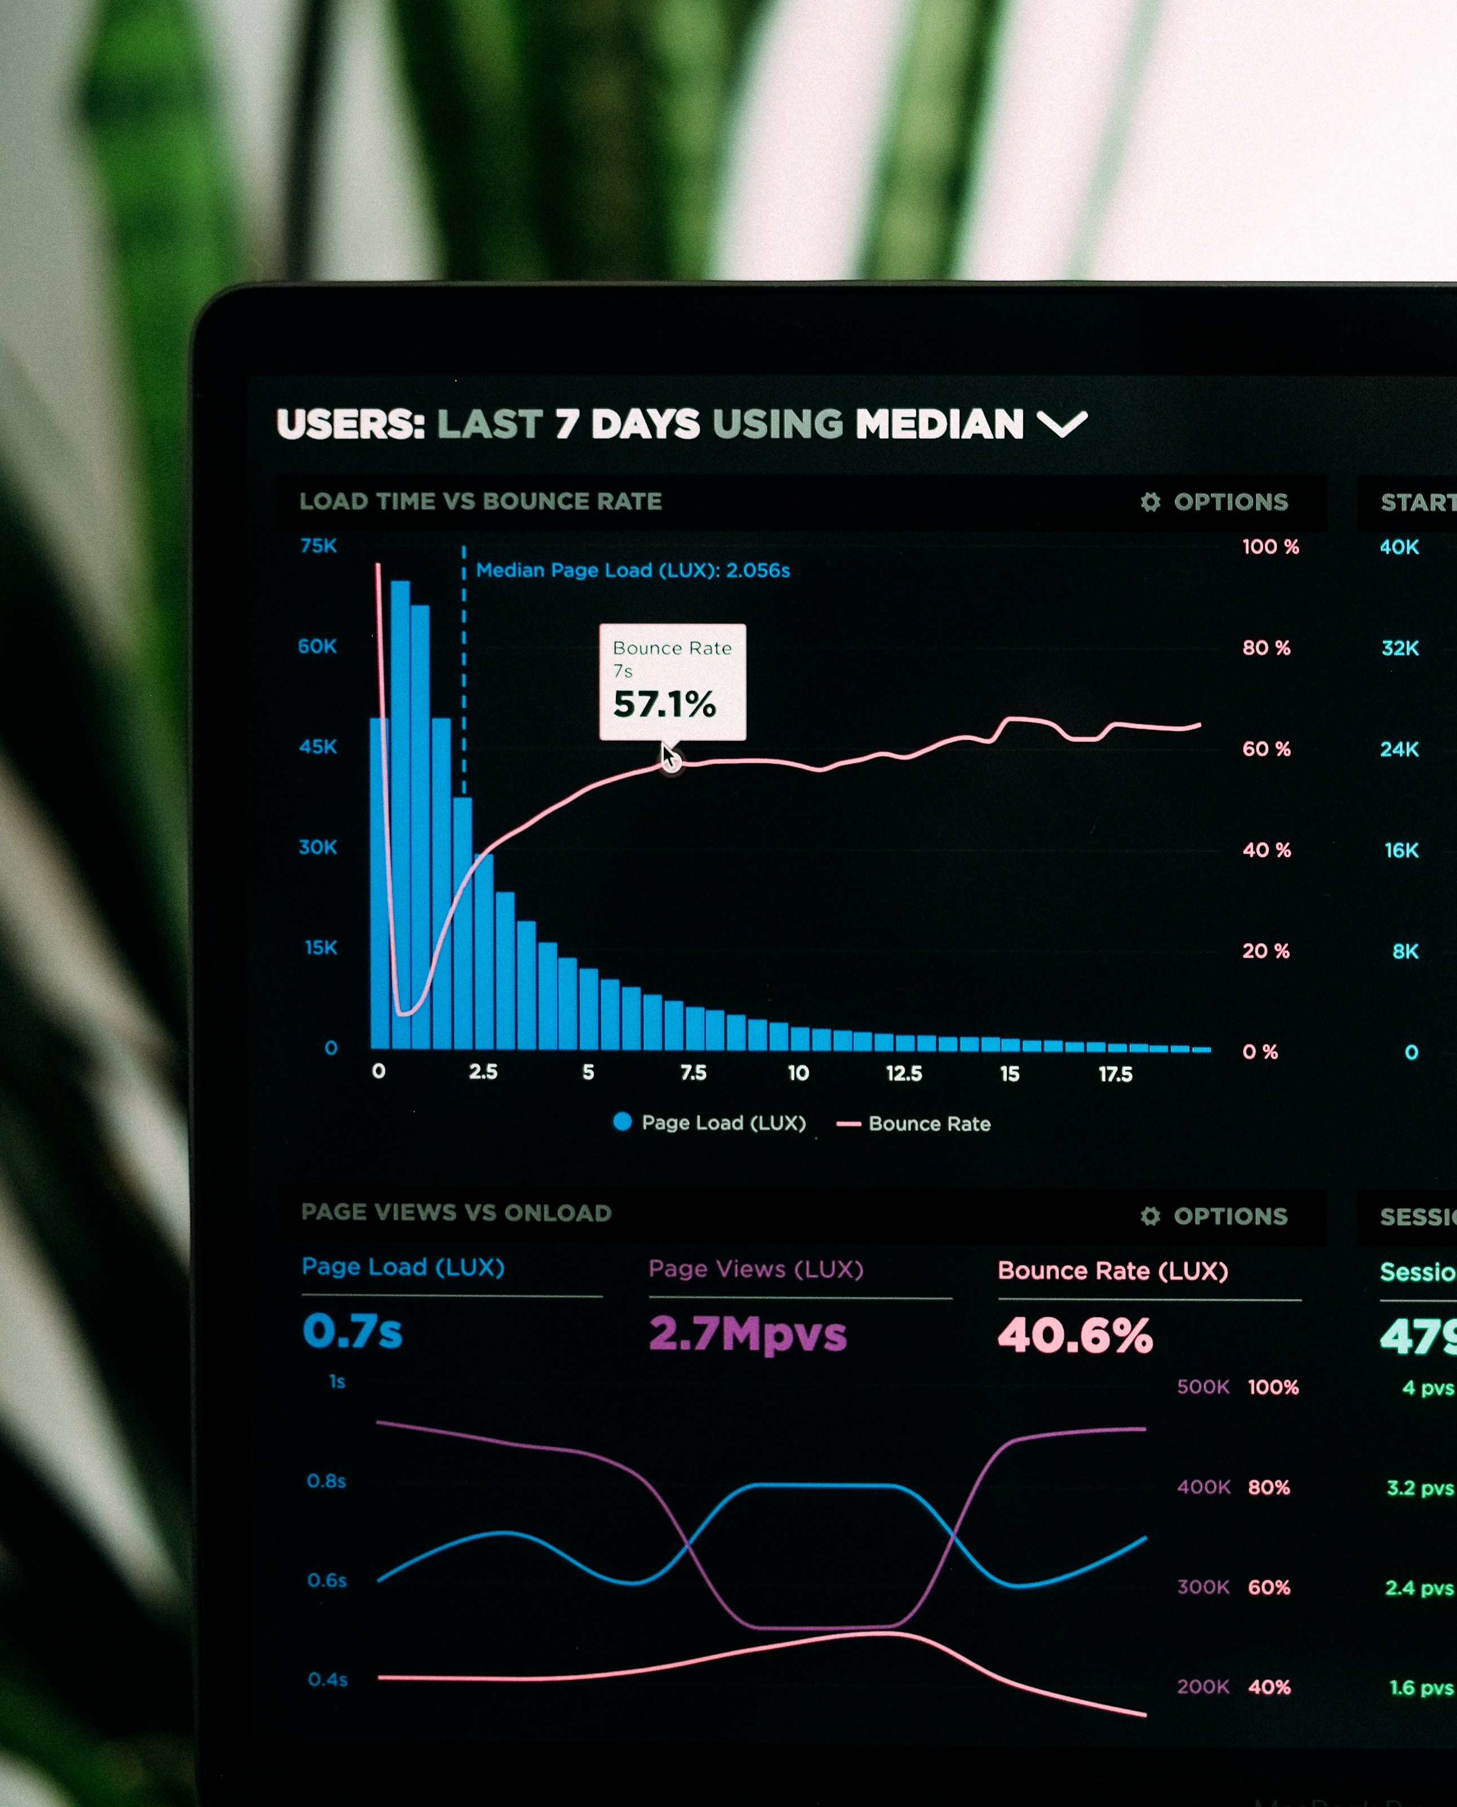
Cautionary Notes
Other common causes we need to control?
You may not have the data you need!
Plan ahead!
Notes:
Understanding → planning → better models

Slide 20
Python Exercise

Slide 21
Common Mistakes

Slide 22
#1: Assess Measurement Validity
Control requires *perfect* measurement
Too narrow? Too broad?
Can test measure properties
What would this actually measure?
Notes:
This is one of the biggest mistakes I see.

Slide 23
Measurement Composites (Latent Variable Models)
Brand
Sentiment
Beyond this workshop, but it’s possible to use weighted sums of several indicators to make a better composite
E.g.,
i1 = App rating
i1 = Use of affect words
i1 = Number of purchases
i 1
i 2
i 3
Notes:
Can estimate weights using a factor analysis. Similar to PCA. Will REALLY HELP

Slide 24
#2: Do not control for mechanisms
Need good understanding to model correctly
Game Familiarity
Hours Played
Social Media Engagement
Fan
Controlling for familiarity with the game would erase the effect of “hours.” Don’t do this!
Notes:
If I controlled for familiarity with the game, I would remove the REASON hours cause engagement. That would be bad. It would undo the effect I am trying to assess.

Slide 25
Python Exercise

